Slide 1
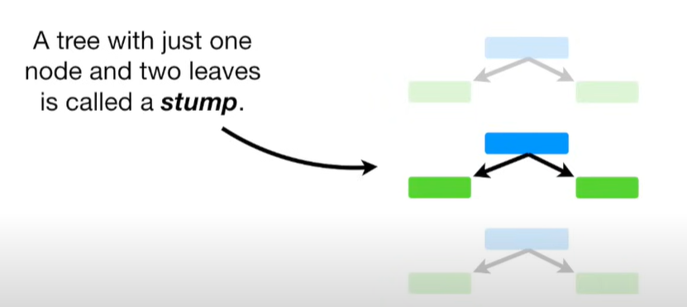
AdaBoost
An AdaBoost regressor is a meta-estimator that begins by fitting a regressor on the original dataset and then fits additional copies of the regressor on the same dataset but where the weights of instances are adjusted according to the error of the current prediction.
AdaBoost is an ensemble model that sequentially builds new models based on the errors of the previous model to improve the predictions

Slide 2
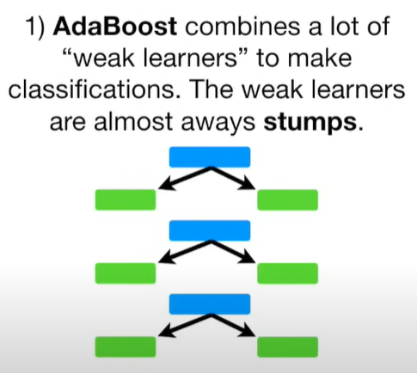
Three main ideas of AdaBoost

Slide 3
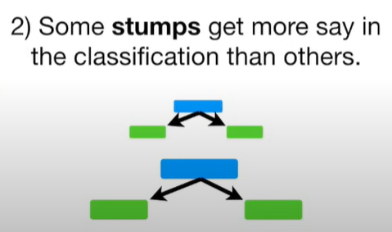
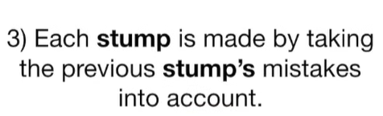
Three main ideas of AdaBoost

Slide 4
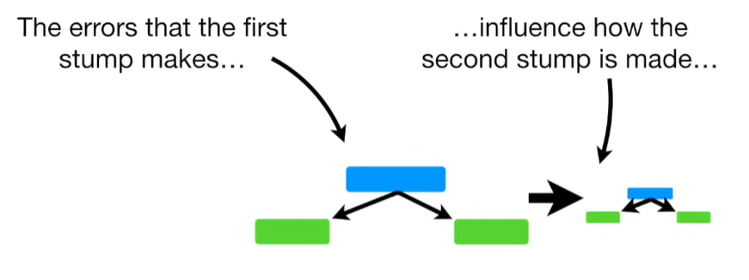

Slide 5
